Slide 1
Welcome to our presentation

Slide 2
Submitted By *Syed Nazmul ID: 141-15-3225 *Maria-Tuz-Zannah ID: 141-15-3191

Slide 3

Project Title
Online Music Store

Slide 4
Proposal
User friendly
Archived option
Get information about all the latest album.

Slide 5
System Overview
Current system
Amazon mp3
iTunes
Sound cloud
DEEZER
Music Beta

Slide 6
Advantage
Create Playlist.
On demand music.
Variety of music.
Available 24*7
Search the music.

Slide 7
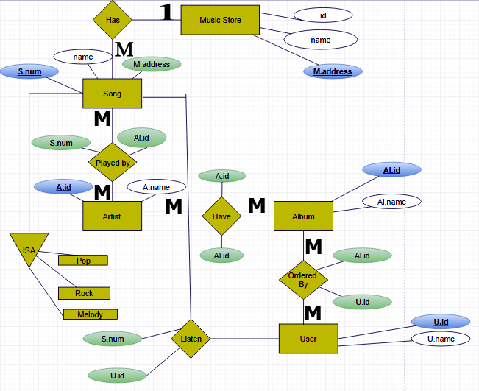
E.R Diagram

Slide 8
Database Schema
Music store ( M.address#, M.id, name )
Song ( S.num#, name, M.address )
Played by ( S.num, Al.id ) Listen ( U.id, S.num )
Artist ( Al.id#, Al.name )
Have ( A.id, Al.id )
Album ( A.id#, name )
Ordered by ( Al.id, U.id )
User ( U.id#, U.name )

Slide 9
IMPLEMENTATION
We develop this project with:
Microsoft visual web developer
ASP.NET
Sql Server
Now it’s a desktop application.

Slide 10
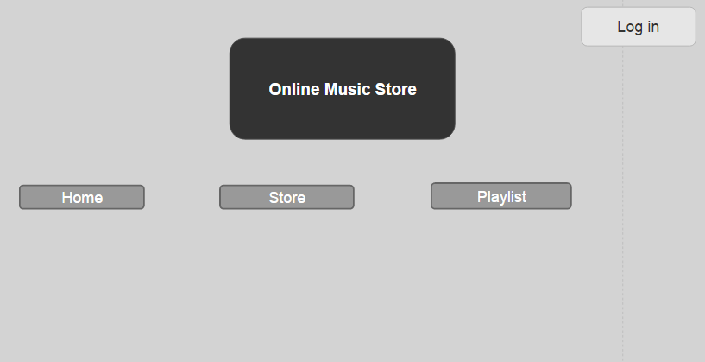
Music will be stored according to genre and it will show the singer’s name also
Track | Singer | Genre
Heal The World | Michael Jackson | Dance, Pop, Rock

Slide 11
Future Enhancements
Integrate this desktop application with mobile app.
Mobile app will be available for all operating system.
Getting upgrade of the project will continue.
To assure its security.
Add Singers Biography.

Slide 12
Thank You

